Slide 1



Slide 2
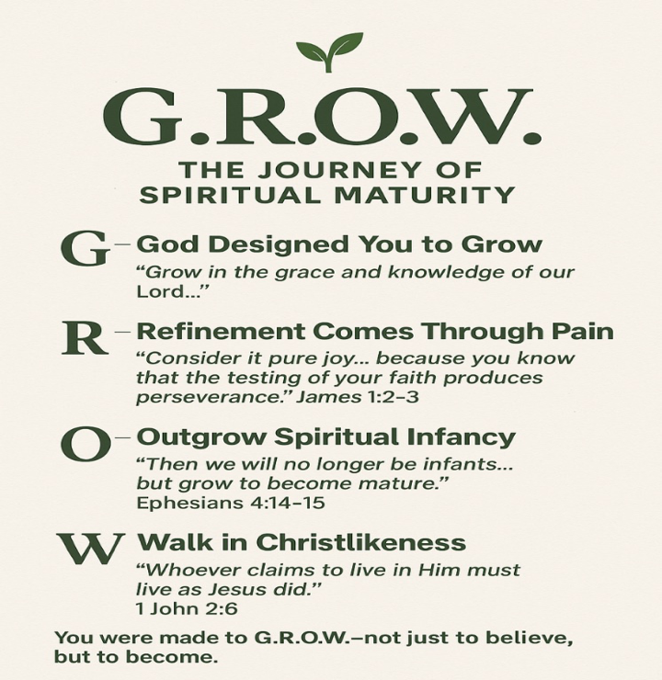
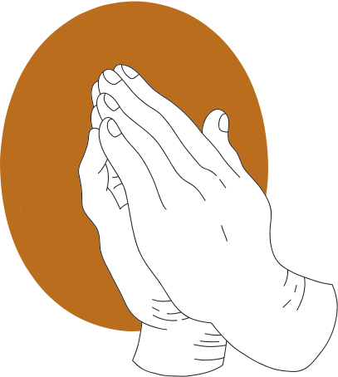


Slide 3
The Rhythm of Repentance

Slide 4
Definition of Repentance
A heart-felt turning away from sin back to God
A change of heart, mind, attitude, direction
Transformed by the Holy Spirit!
The Rhythms of Faith

Slide 5
Why Do We Resist Repentance?
1. It confronts our pride
2. It disrupts our comfort
3. It breaks us open

Slide 6
Why do we Resist Repentance?
“The sacrifice God desires is a broken heart ….
a broken and repentant heart.”
Psalm 51:17
“Don’t you see how wonderfully kind, tolerant, and patient God is with you?.... his kindness is intended to turn you from your sin.”
Romans 4:2 (NLT)

Slide 7
Takeaway #1
We resist repentance because it
breaks us open; but that very breaking
is where God begins
His healing & restoration!
The Rhythms of Faith

Slide 8
Takeaway #2
God often does His deepest work in us
through the seasons
we never choose!
The Rhythms of Faith

Slide 9
Matthew 4:17
“Repent, for the Kingdom of heaven
has come near.”

Slide 10


Repentance &
the Kingdom of God

Slide 11
Repentance & God’s Kingdom
Repentance is the gateway to the Kingdom
Repentance aligns us with the King’s will
Repentance transforms our perspective
“Your kingdom come, your will be done,
on earth as it is in heaven.” -- Matthew 6:10

Slide 12

“People on earth hate
to hear the word
‘repent.’ Those in hell
wish they could hear
it just once more.”
A.W. Tozer

Slide 13
Takeaway #3
Repentance isn’t just how we enter the Kingdom —
it’s the daily rhythm that shapes how we live and G.R.O.W. in It!
The Rhythms of Faith

Slide 14
Repentance:
3 Misunderstandings

Slide 15
Misunderstanding #1
Repentance is just saying sorry!
The Truth:
Genuine repentance involves 3 stages:
Acknowledge / Confess
Godly sorrow
Turn & walk in obedience

Slide 16
“Godly sorrow brings repentance that leads to salvation & leaves no regrets.”
-- 2 Corinthians 7:10
“Repent, then, and turn to God,
so that your sins may be wiped out,
that times of refreshing may come.”
-- Acts 3:19

Slide 17
Misunderstanding #2
Repentance brings instant healing!
The Truth:
God forgives instantly, but
healing & restoration is a journey
Stay humble & steadfast
Walk with Him
Be obedient

Slide 18
“Have mercy on me, O God!”
-- Psalm 51:1
“Create in me a pure heart, O God, and renew
a steadfast spirit within me …..
Restore to me the joy of your salvation
And grant me a willing spirit to sustain me.”
-- Psalm 51:10, 12

Slide 19
Misunderstanding #3
Repentance is only for “big sins”!
The Truth:
We fall short daily in
thoughts, motives & decisions!
In repentant & rest
In quietness & trust

Slide 20
“I don’t really understand myself,
for I want to do what is right, but I don’t do it.
Instead I do what I hate ….
Oh, what a miserable person I am!”
-- Romans 5:15, 24 (NLT)
“In repentance & rest is your salvation,
in quietness & trust is your strength.”
-- Isaiah 30:15

Slide 21
Takeaway #4
Repentance is not a one-time fix --
it’s a lifelong rhythm of
surrender & realignment!
The Rhythms of Faith

Slide 22
Today’s Takeaways
We resist repentance because it breaks us open.
God often does His deepest work in us through the seasons we never choose.
Repentance isn’t just how we enter the kingdom – it’s a daily rhythm that shapes how we live & G.R.O.W. in it.
Repentance isn’t a one-time fix – it’s a lifelong rhythm of surrender & realignment.
The Rhythms of Faith

Slide 23
Self-reflective Questions:
Have I allowed pride, busyness or distraction to dull my need for repentance?
2. When was the last time I experienced godly sorrow?
3. What is one area the Spirit is inviting me to surrender?

Slide 24
The Rhythm of Repentance

